Slide 1
Steganography
MACY NEBLETT
MADDIE QUISTGAARD
KAHLIL SAMPLE
AMANDA RAE
ANNA STEFFENSMEIER

Slide 2
STEGANOGRAPHY
Steganography is the process of hiding messages inside of a digital image in a way that is visually undetectable to the human eye. The text is embedded by converting the digital image into a matrix and replacing the least significant bits of the image with the text message.

Slide 3
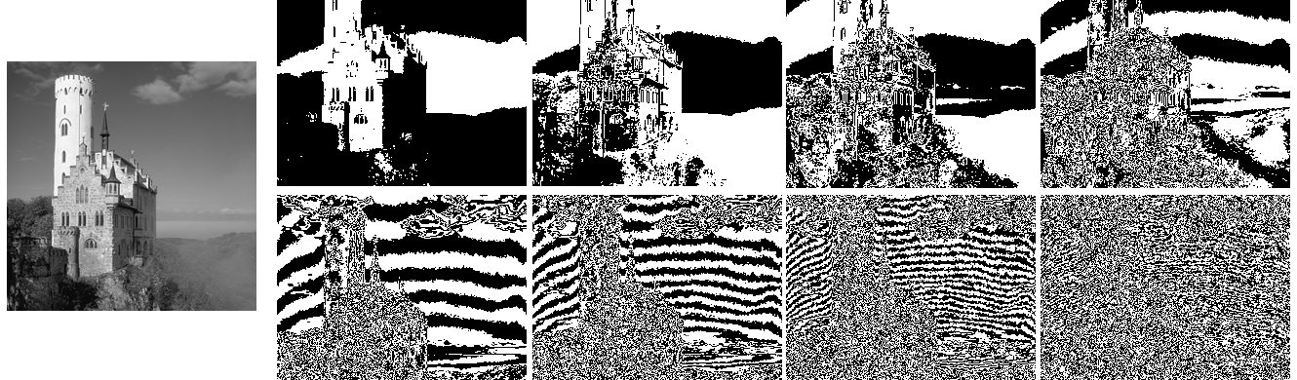
LSB
A bit plane is a set of bits corresponding to a given bit position in each of the binary numbers representing the signal. For example, for 8-bit data representation there are 8 bit planes: the first bit plane contains the set of the most significant bit, and the 8th contains the least significant bit.

Slide 4
STEGANOGRAPHY VS STEGANALYSIS
Steganalysis is the study of detecting messages that were hidden using steganography.
The process of detecting a stego image is done by looking at variances between bit patterns and unusually large file sizes.

Slide 5
STEGANOGRAPHY VS CRYPTOGRAPHY
Cryptography hides the contents of a secret message, whereas steganography conceals the existence of the message.
In cryptography, the structure of a message is scrambled to make it meaningless and unintelligible unless the decryption key is available.
Steganography does not alter the structure of the secret message.
Cryptography and steganography are generally used in tandem.

Slide 6
CHI-SQUARE
Statistical test applied to sets of categorical data to evaluate how likely it is that any observed difference between the sets arose by chance.
Specifically for LSB replacement steganalysis because LSB replacement locks least significant bits into pairs.
Chi-square only works with embedded images that are embedded lexicographically.

Slide 7
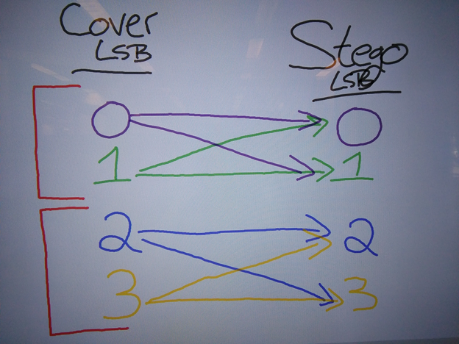
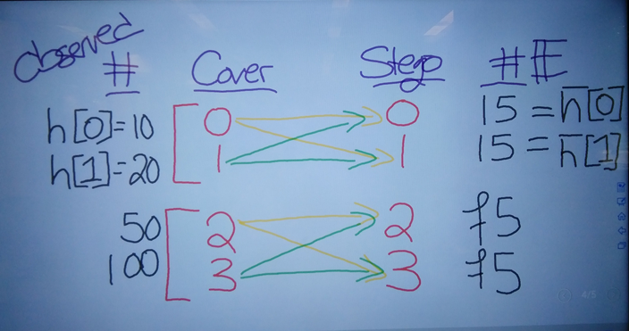
Chi-square

Slide 8
Chi-square
H₀: h[0] = ħ[0]
Number of pixels in the image with value 0 is close to the average number of pixels in the image with values equal to 0 or 1. This is expected if the image is a stego.
H₁: h[0] ≠ ħ[0]
Number of pixels in the image with value 0 is not close to the average number of pixels in the image with values equal to 0 or 1. This is expected if the image is a cover.
This is done for all pairs.

Slide 9


Chi-square
h[2K] is what is being observed
ħ[2K] is the expected value =
p-value = (S > α | X=stego)
If p is small, reject the H₀ => image is a cover
If p is large, fail to reject H₀ => image is a stego

